Slide 1
Reverse Engineering for Baiscs

Slide 2
This is Part 1
Am lazy, we’ll do more complicated stuff one day.
For now, we’ll start with the basics.

Slide 3
What
Open stuff, understand it. Vomit it to other people so they can understand it
Extract IOCs from sample
Fun
You can save it, so you can potentially use it for personal purposes (WITH PERMISSION)
i.e for blogs, you wanna use it, learning purposes

Slide 4
Prerequisites
As we are at part 1, you are gonna need to know
Programming. Its…
IMPERATIVE. DON’T BELIEVE SOMEONE YANG CAKAP BENDE NI TK PENTING. ALSMOT 100% OF WHAT YOU GONNA DO IS LEARNING HOW DO PROGRAM WORKS. AND HOW YOU KNOW IT WORKS BY READING THE REVERSED PROGRAM. WHICH YOU GONNA NEED TO KNOW PROGRAMMING IN THE FIRST PLACE. YOU WONT UNDERSTAND THE FWICK IS A PROGRAM THAT GIVES REVERSE SHELL, IF YOU CANT EVEN READ PROGRAMMING LANUGAGE. Finish ranting
That’s all. Because for part 1, we’ll look through some basic samples that you won’t necessarily have to reverse to understand.

Slide 5
Some Learning Points that we should learn by the end of this presentation hopefully maybe probably
Reversing Basics
Some interesting functions to look out for
Deobfuscation techniques

Slide 6
What will you need for “advencture”
A text editor that you are comfortable with -> Reading Code
i.e Visual Studio Code, Sublime, Nano, Notepad++, notepad
Open up Cyberchef -> Deobfuscate code if needed
https://cyberchef.org/
A virtual machine that has no internet connection with a snapshot, because we are probably gonna attempt some dangerous dynamic analysis

Slide 7
Insert some examples of languages we want to explore
Python (Compiled and source code) (Which I will show how to detect and decompile it to source code if possible)
Keylogger
Reverse Shell
Data Exfiltration
Sample online
Java
C2
Sample online
Powershell (encoded and not)
Ransomware
Data Exfiltration (Me taking from recent-recent powershell script)
PHP
Webshells
Reverse shell
Ok, bawah ni not yet
APK
C# (Using dnspy/ilspy)
Show using DIE (Detect It Easy) -> To show obfuscation possiblity

Slide 8
Reversing Basic basics
Again, we are not going into the using IDA, Ghidra, or debugging territory yet
We’ll just, read some code and say its malicious.
And decompile as needed if need be

Slide 9
The question?
What makes a code/script malicious?
Usually something that does the MITRE framework
Famous Example includes:
Reverse Shell
Credential Harvesting
Data Exfiltration
Tunneling

Slide 10
Example
https://github.com/birminghamcyberarms/QRLog/blob/main/samples/QRCodeWriter.java
Um, link kat github

Slide 11
Obfuscation
Making it HARD TO READ/Reverse
All kind of forms. Examples include:
String Obfuscation
Adding dummy/benign code
Use maths (API Hashing techniques)

Slide 12
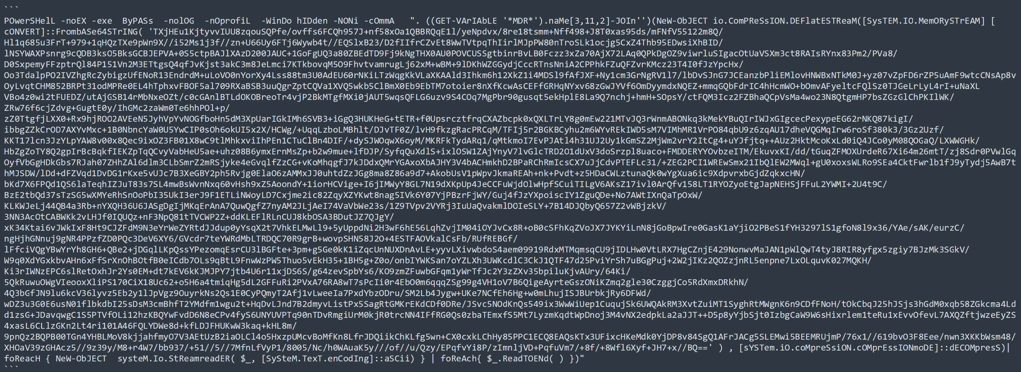
Examples of Obfuscation

Slide 13
To Deobfuscation
Many ways (Maybe).
It is probably gonna take some time to deobfuscate, hence the term “Making it hard to read/reverse”
Not that complicated. Less complicated than reversing at least
Some go-to methods I use, most of the time. (Name of probably not correct, this is just me making names)
Available deobfuscation tool on Github (easiest way)
i.e De4Dot
Runtime Deobfuscation
Manual Deobfuscation

Slide 14
What you gonna do
If you found a tool on Github, use it. PLEASE
Manual Deobfuscation
Look at the code and see if you can manually deobfuscate it.
If it is a string “concatenation” type obfuscation, then concat the strings manually etc…
If you think it is too tedious. That’s the point.
Then try, Runtime deobfuscation
Take some line of code that has been obfuscated, print the result of the string when the line of code is used.
Replacing the “Execution” part of the script with “print”

Slide 15
Examples of Tools
General String -> Floss
C# -> De4dot
Powershell -> PowerDecode

Slide 16
Examples
In cases for Powershell, “IEX” is one of the most aspect you should look out for
Basically means, run this string as an actual script/command
So, remove the IEX and replace it with “echo” or “write-host”
If they have an associated function to deobfuscate their script. Well, it can be counted as encryption now technically. Don’t forget to include the function call.

Slide 17
FAQ
ChatGPT is good?
Mixed. If you want to understand an UNOBFUSCATED code in summary, that is fine. If you want to depend ChatGPT to do the deobfuscation for you, DO NOT.
It’s bad, and its fussy about “Oh no, I can’t execute code for you”

Slide 18
Refrence
Obfuscation Techniques
https://conference.hitb.org/hitblockdown002/materials/D2T2%20-%20A%20Review%20of%20Modern%20Code%20Deobfuscation%20Techniques%20-%20Arnau%20Gamez%20Montolio.pdf
https://book.hacktricks.xyz/mobile-pentesting/android-app-pentesting/manual-deobfuscation
https://infosecwriteups.com/deobfuscation-for-beginners-944947ee2b9f
https://fareedfauzi.github.io/2021/02/06/LemonDuck-Powershell.html
https://fareedfauzi.github.io/2021/05/11/Understanding-Powershell.html
https://perl--users-jp.translate.goog/articles/advent-calendar/2010/sym/11?_x_tr_sl=auto&_x_tr_tl=en&_x_tr_hl=en&_x_tr_pto=wapp

Slide 19
Reference
https://github.com/davidbombal/python-keylogger/blob/main/keylogger.py

